Slide 1
Hourly Recruitment Application

Slide 2
Objectives
Designing of a web application “Hourly Recruitment Application” to allow anyone to sign up as a recruiter or as a worker.
The clients should be able to post a job along with the necessary job requirements.
The freelancers should be able to see the job posted and can start bidding with their quotes and time period they require to finish the task.
The client should then see all the bids and select any one bidder and upon mutual agreement the contract will begin.
Payment will be calculated on the bases on the business hours.

Slide 3
Technologies Used
Frontend Framework (React): React for building interactive user interfaces.
Backend Framework (Node.js and Express.js): Node.js for server-side JavaScript execution. Express.js as the backend framework for handling server-side logic and routing.
Database Management (MongoDB): MongoDB as database to store and manage data efficiently.
Version Control (Git): Git for version control to track changes, collaborate, and manage the project's source code.
Development Environment: Visual Studio Code was used as the IDE.
Styling (SCSS): CSS for basic styling and layout.

Slide 4
Architecture

Slide 5
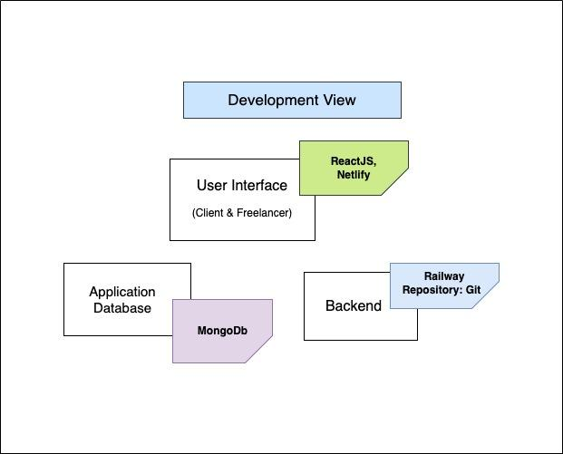
Logical View
User Interface
(Frontend)
Hourly Recruitment Server
Database

Slide 6
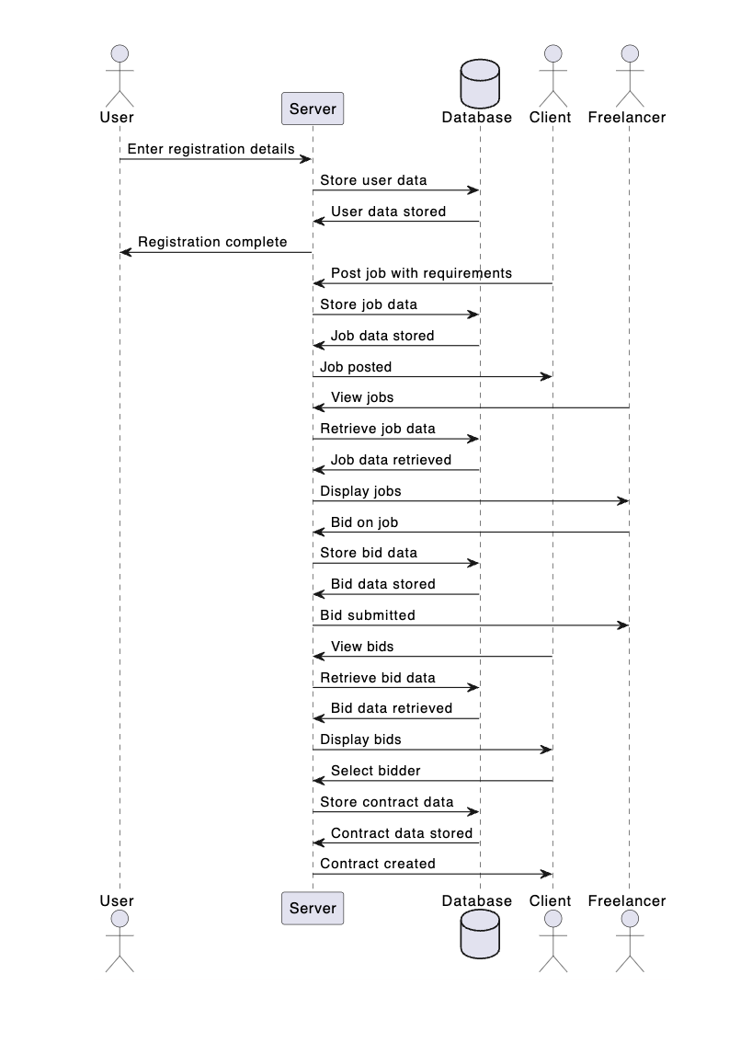

Slide 7
Frontend
User Authentication and Registration: Frontend components for user authentication and registration forms. React for dynamic user interfaces, allowing users to sign up as clients or freelancers.
Interactive dashboard using React components: Enabling clients to post jobs, manage contracts, and view billing information.
Dedicated freelancer dashboard for viewing available jobs and managing bids: Displaying jobs using React components with detailed requirements.
Bidding System: Bidding system with React components for freelancers to submit bids.
Contract Agreement and Billing: Contract agreement and billing calculations for each project.

Slide 8
Backend
User Management: Node.js APIs(passport) for user authentication, registration, and profile management. Express.js for handling HTTP requests and responses.
Job and Bid Management: APIs for posting, updating, and deleting jobs. Bid management APIs for freelancers to submit bids and clients to review them.
Contract Management: APIs for finalizing contracts.
Billing System: Billing system APIs to calculate charges based on agreed-upon rates and timeframes.

Slide 9
Database
MongoDB Schema: MongoDB database schema for storing user profiles, job details, bids, contracts, and billing information.
User: first_name, last_name, type(client,freelancer/admin), username, password, createdAt, skills
Project: title, description, technologies, clientId, duration, status, freelancerId, accepted_bid, approved_submission, submission_url
Submission:clientId, freelancerId, projectId, sourceCodeUrl, demoUrl, hostedUrl, accepted_at
Bid: clientId, freelancerId, projectId, hourly_rate, accepted_at

Slide 10
Q & A:
Q: What is the primary goal of the project?
A: The main objective of the project is to create a web-based Freelance Platform that connects clients with freelancers, enabling seamless job posting, bidding, and contract management.
Q: Which technologies were chosen for the project?
A: The project utilizes the MERN stack (MongoDB, Express.js, React, Node.js) for its backend and frontend development. Additionally, Git is employed for version control, and SCSS is used for styling.
Q: How does the system handle user authentication and authorization?
A: User authentication is managed using passportjs, providing secure access to clients and freelancers. Role-based access controls ensure that users have appropriate permissions.

Slide 11
Q: What challenges were encountered during the implementation phase?
A: Challenges included the integration of a payment gateway and ensuring real-time communication using WebSocket. These were addressed through thorough testing, early engagement with providers, and contingency plans for potential delays.
Q: How was the user interface designed to enhance user experience?
A: The user interface was designed using React components, ensuring responsiveness and a seamless experience. SCSS was employed for styling, allowing for modular and maintainable stylesheets.
Q: What testing strategies were employed to ensure system quality?
A: The project underwent comprehensive testing, including unit tests for each module and integration tests for the entire system. Testing involved addressing edge cases and ensuring robust functionality.

Slide 12
Q: How does the system address potential security risks?
A: Security measures include secure coding practices, HTTPS implementation, and input validation to prevent common vulnerabilities. User authentication is handled using hashing for added security.
Q: What lessons were learned from the challenges faced during development?
A: The challenges provided valuable insights into payment gateway integration, real-time communication, and third-party dependencies. Lessons learned include the importance of early engagement, thorough testing, and proactive risk management.
Q: Are there any planned future enhancements for the project?
A: Future enhancements may include additional features based on user feedback, such as advanced search functionality, enhanced job categorization, and improved communication tools. Regular updates and maintenance are planned to ensure the platform's continued success.

